Slide 1
CAPSTONE PROJECT : The battle of neighborhood

Slide 2
Agenda
Problem
Data
Methodology
Results
Discussion
Conclusion

Slide 3
Problem
ABC Leisure Limited is a famous multiplex chain, which operate mainly in western and northern part of India, wants to start it’s business in the eastern part of the country.
The company want to start it’s business from Kolkata as it is one of the major city of eastern India.
The target of the company is to find out a suitable place in Kolkata where it can start 1st movie theatre.
If the business is successful, it will further plan to extend its market in the eastern India.

Slide 4
Data
The area of Kolkata district is divided among various small parts, which are in the jurisdiction of different post offices.
All post office area has a unique pin code, which can be used to identify the post office/the area under the post office.
This dataset is available on the following link,
https://finkode.com/wb/kolkata.html
Foursquare API is used to explore other venues/competitors in the locality.

Slide 5
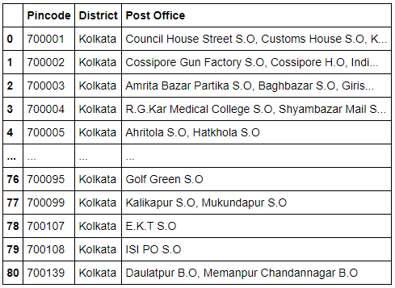
Methodology
After scraping the data from web, we store it in pandas data frame.

Slide 6
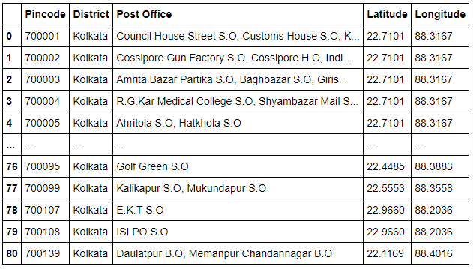
Methodology
Latitudes and Longitudes of each area are found using module pgeocode.

Slide 7
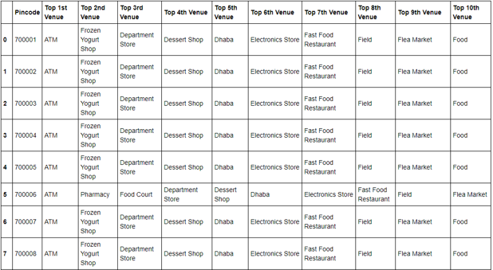
Methodology
Use Foursquare API and one hot coding to find the top 10 venues of each area.

Slide 8
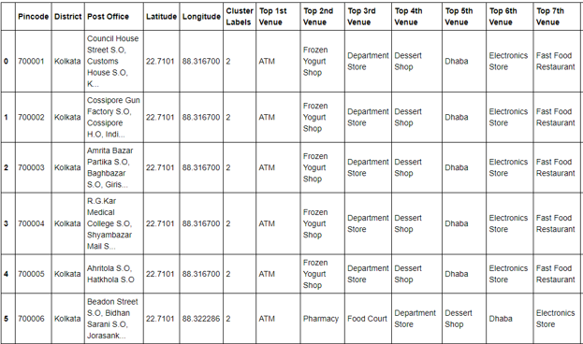
Methodology
Use Kmeans clustering to find the cluster labels of each area.

Slide 9
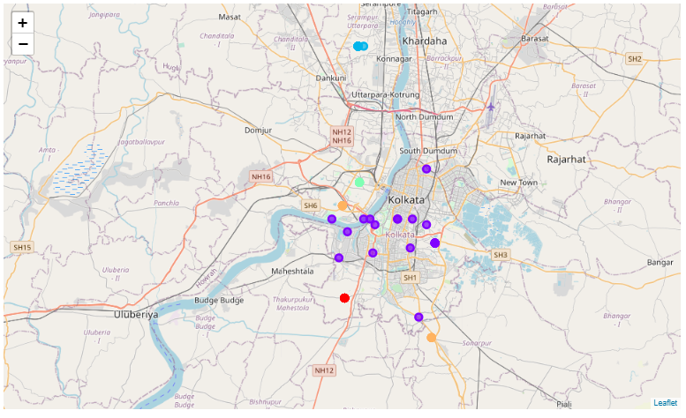
Methodology
Plot the map using folium library.

Slide 10


Results
The number of areas in each cluster is,
Pin code of area in cluster 1 where Movie Theater is available,

Slide 11
Results
Pin code of area in cluster 2 where movie theater is available,
No movie theater is available in cluster 3, cluster 4 and cluster 5.

Slide 12
Discussions
It seems if a company starts its new business in any area on cluster_1 it will be very competitive and difficult to get the success.
The size of cluster_2 is almost 2.5 times of cluster_3 and cluster_5.
Big cluster size means population is also very high, hence though cluster_2 has one movie theater it will be good to start a new theater in this cluster.
Second choice will be cluster_3 or cluster_5 as no movie theater exists and size is also comparatively bigger than cluster_4.

Slide 13
Discussions
Third or last choice will be cluster_4, which contains least number of area.
Cluster_1, is not recommended due to high level of competition.

Slide 14
CONCLUSION
The purpose of the project is to identify which area is in Kolkata is best to open a new movie theater for ABC Leisure Limited.
As Kolkata is very high-populated city, we assume that if the size of area is big, population of this area is also high comparatively.
In order to aid the company to look the optimal location of a movie theater, we used foursquare API to explore different areas of Kolkata.
Final decision on optimal location of a new movie theater will be made by stakeholders based on specific characteristics of location and other factors like convenience of each location (proximity to station), availability of nearest city center etc.

Slide 15
Thank You

